Slide 1
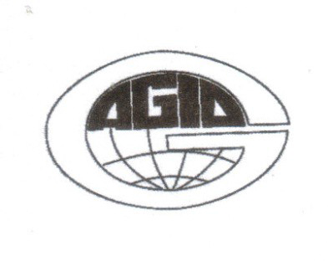
At the intersection of science and politics: the process of "scientists" in L'Aquila
Association of Geoscientists for International Development (AGID)
Prague Conference 2015
Francesco GM Stoppa http://orcid.org/0000-0002-4218-2549
and
Lalliana Mualchin http:// orcid.org/0000-0001-8747-7044.
"Few events in the history of modern science have been so much misunderstood as the prosecution of L'Aquila" (Alexander, D.E, 2014)

Slide 2
Who we are
The International Seismic Safety Organization (ISSO) has been formed by a volunteer group by adopting its Position Statement in June 2012 to promote public safety by being prepared for the largest potential events and the like before their eventualities. Membership is welcome from anyone from any background interested in public safety. We have members from 14 countries.
http://www.issoquake.org
Signed by Benedetto De Vivo, ITALY – Indrajit K. Ghosh, USA – Allen W. Hatheway, USA – Jens-Uwe Klügel, SWITZERLAND – Vladimir G. Kossobokov, RUSSIAN FEDERATION – Ellis L. Krinitzsky, USA – Efraim Laor, ISRAEL – Alessandro Martelli, ITALY – Lalliana Mualchin, USA – Giuliano Panza, ITALY – Antonella Peresan, ITALY – Mark R. Petersen, USA – Francesco Stoppa, ITALY – Augustin Udias, SPAIN

Slide 3
What cause disasters:
The consequences of earthquakes and inadequate preparations.
Tsunamis, liquefaction and land-slides are the consequences of earthquakes.
Collapsed and failures of buildings, bridges, and other structures are the consequences of inadequate preparations.
Inadequate preparations include using low earthquake design, much lower than produced by such events so that buildings cannot withstand earthquake forces and they failed .
Inadequate preparations include not warning people for such possible eventualities.

Slide 4
Keys to safety:
Have realistic estimate of the maximum credible earthquake, (MCE) and its scenario as an ultimate target for civil protection.
Plan new settlements outside earthquake-prone or in relatively “safe” areas.
Building structures must be designed and constructed to withstand earthquake forces.
Evacuate to a safe place when warned of an impending earthquake.
Moving quickly to pre-determined safe locations in the event of a sudden earthquake.
Have a comprehensive large scale plan in the event of MCE’s.

Slide 5
Introduction
On April 6th, 2009, at 3:32 am, a moderate earthquake of Mw 6.2 (± 0.1) struck L'Aquila.
Over three hundred people died and thousands were injured, hundreds seriously.
The L'Aquila earthquake gave rise to legal action for wrongful death against the scientists who just days before had attended a meeting of the Commissione Nazionale per la Previsione e la Prevenzione dei Grandi Rischi (CGR), to assess the risk in view of the recent seismic activity.

Slide 6
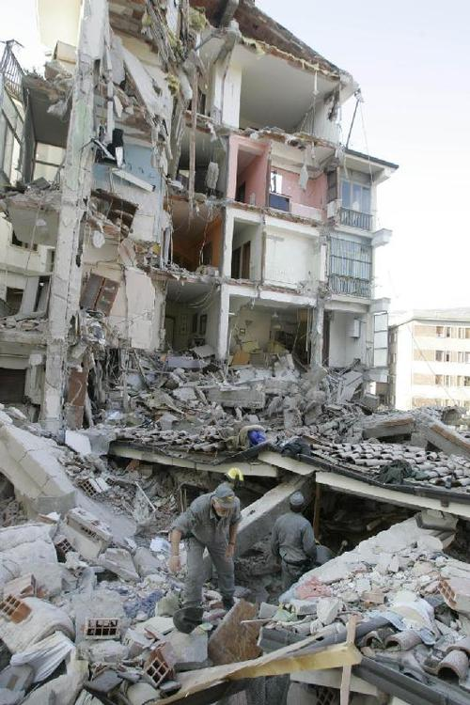
Fifty-five students died in the earthquake, eight of which in the collapse of the college hostel, and according to many survivors, they had felt reassured interpreting foreshocks as energy dissipation, as reported by a spokesman for the Civil Defense.
Many others had had the guarantee that the collapsed buildings were instead "solid" and "strong".

Slide 7
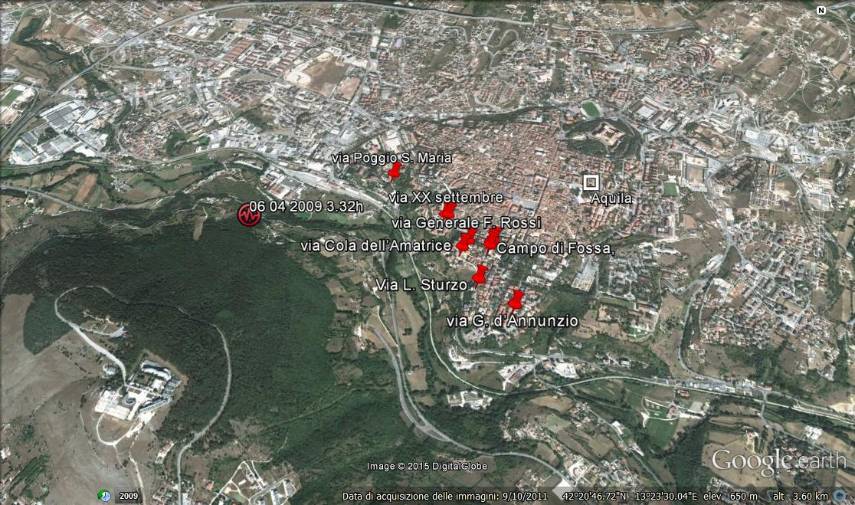
Most of the victims in L’Aquila were due to the total collapse of seven concrete buildings

Slide 8
From 28 October 2008 until 26 March 2009, seismic activity increased significantly in the area of L'Aquila at a value of 2.2 x day events / background.
On 29 marzo 2009, Giampaolo Giuliani forecasted an impending earthquake in Abruzzo as inferred by fluctuations in the Radon measurements detected by four experimental radonometers
10 days before the main shock occurred a concentration of hypocenters on the Paganica fault, and an increase of seismic activity up to 21.7 events / day and in magnitude.
March 30, 2009. The head of the Dipartimento Protezione civile, G. Bertolaso, convened a meeting of the CGR for the following day. A charge of "false alarm" was issued against Giuliani and an injunction forbiden him to publicize his views and data on the Internet. On the same day it occurs in L'Aquila, an earthquake measuring 4.1.

Slide 9
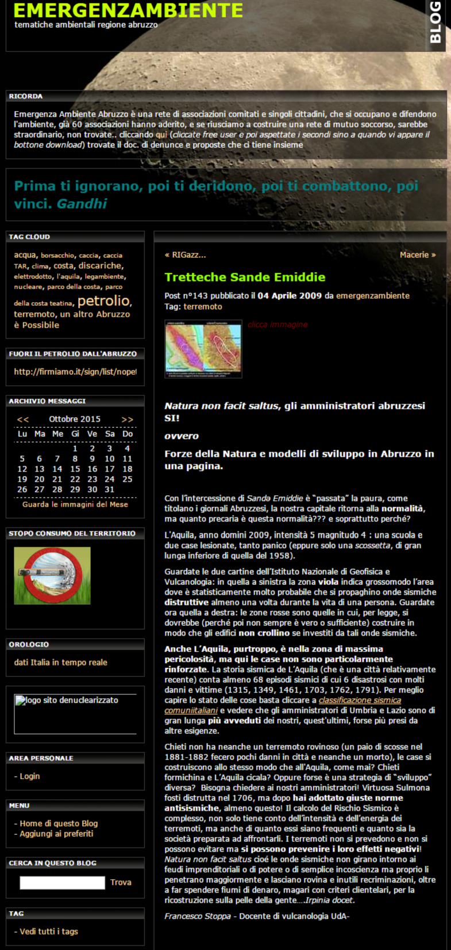
Witness Francesco Stoppa*
The introduction of the witness Francesco Stoppa, thiese are warned by the judge of his obligations and makes the statement Former Article 497 CPP: "Aware of the moral responsibility and that I take with my legal testimony, I commit myself to say the whole truth and not to hide anything that is in my knowledge “.
Civil Party Lawyer, Della Vigna - Here comes that which was published on April 4, 2009, tell me if I'm wrong, ‘tretteche Sande Emiddie, Natura non-facit saltus, Abruzzo’ s Administrators do’. It is the attachment No. 11 deposited in acts, where he speaks of situation, 4 April 2009...It also has two maps,…..
Witness, Stoppa F. - With the language of the blog ... Blogs are a way to communicate thoughts in a very free way, of course this was posted, so I think it says, Emergency Environment which is a great association that deals with environmental issues, risk…..
* a copy of my testimony is available on request.

Slide 10
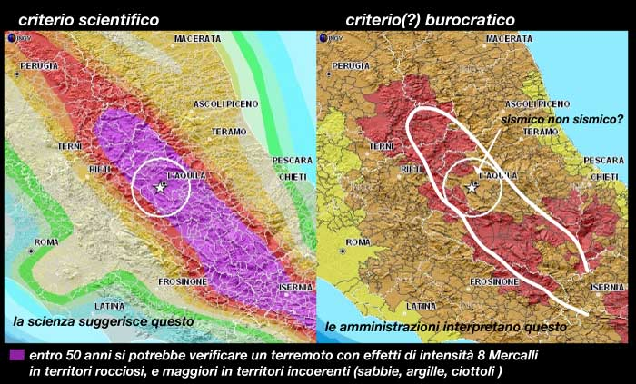
Comparison between hazard and seismic classification of the area before the earthquake of L'Aquila

Slide 11
In May 2011, the court of L’Aquila has authorized a formal indictment for manslaughter and injury to Franco Barberi, Enzo Boschi, Claudio Eva, Gianmichele Calvi, Mauro Dolce, Giulio Selvaggi, Bernardo De Bernardinis.
On June 2011 INGV distributed to the scientific community a letter of support for scientists of CGR to be sent to the President of Italy. In a few weeks collected over 5,000 signatures. Some expressions rhetorically charged and highly prejudicial have taken hold and spread rapidly from newspapers and other sources: scientists L'Aquila are scapegoats; Science is attacked; science has been put on trial. Comparisons with Galileo spread virally.
Judge Billi issued a guilty verdict, October 22, 2012 that "the judgment of liability is not made with 'hindsight' based on the failure prediction of earthquake" All members of the CGR are subject to "the functions of risk assessment, forecasting and prevention of death and injury imposed by law." Billi concludes that as a result of communicating false reassurance that emerged from the meeting of CGR, many residents in L'Aquila have changed by abandoning their traditional habit of precautionary practices.

Slide 12
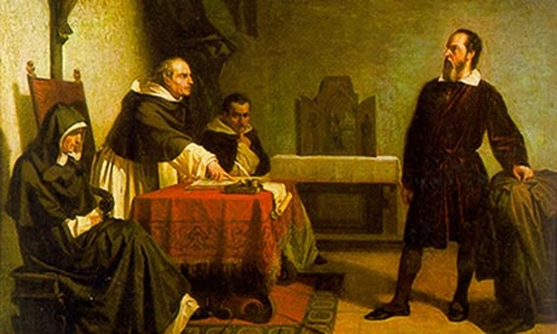
The "trial of science"? A total lie!
The letter composed by leaders of the Istituto Nazionale di Geofisica e Vulcanologia (INGV) reads: “colleagues have been prosecuted for not having foreseen the earthquake."
Nature (June 22, 2010) relaunched the cry of alarm with no real knowledge of the charges. The indictment motivations do not contain a single word referring to the foreseen the earthquake.
In the wake of Nature and Science, journals such New York Times, Washington Post or The Guardian, have globalized the mantra of "the process to the science“. Comparisons with Galileo’s trial spread virally on the web, globalizing the mantra of "science is on trial “

Slide 13
This opens a question of ethics?
With reference to Galileo, re-read his last words in the text of Brecht (The Life of Galileo, scene XIV): "For some years I had the strength of a public authority; and I put my knowledge at the disposal of the authorities so that they would use, or not use or abuse of it, depending on their purpose. (...) I betrayed my profession and when a man has done what I did, his presence can not be tolerated in the ranks of science“.
If autonomy of research and academia fails, it is not possible to produce and disseminate objective knowledge. It will not be possible to derive useful applications. We must always be aware of this fact when accepting to be in an advisory board, and in writing bylaws of a scientific institution
Roberto Cubelli
Professore Ordinario di Psicologia Generale
Università di Trento

Slide 14
After the start of the trial proceeding emerged the recording of a telephone conversation of Bertolaso (The Republic, January 2012), in which he discusses the program of the meeting.
"I send the Scientists there mostly as a media operation. They are the best experts in Italy, and they will say that it is better to have a hundred 4 Richter shocks, because shocks release energy, so that there will never be a big shock "
As concluded by judge Billi, a crucial issue for the interpretation of this is the extent to which members of CGR were "conscious and uncritical" participants in a "media operation" by Bertolaso and failed to exercise independent judgment.
This link suggests that at least he was a participant "conscious and uncritical"

Slide 15
The International Seismic Safety Organization (ISSO) has issued a letter to the Italian president denouncing that "misinformation on this issue deliberately led the scientific community and the public to believe incorrectly, that the reasons for the trial of members of the CGR consisted in the inability to predict the earthquake”
The letter ISSO distanced from the open letter that was sent to the president "before the trial, on the basis of false assumptions" and expressed "disappointment that a wrong position that persists even now, after the process“
You can sense the frustration and pervasiveness of interpreting the trial as anti-science as ISSO’s letter stated: that the "already available trial documentation shows that science has not been questioned or attacked", and that "interpreting the trial as an attack on science and scientists by the critics is distorting the facts.

Slide 16
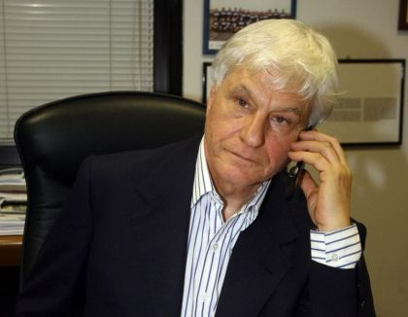
A recent example takes us into the heart of this debate on ethics, which continues on the wrong track imposed by the leaders of the Istituto Nazionale di Geofisica e Vulcanologia (INGV) and endorsed by major scientific and non scientific magazines.
In his letter that Science published in late September 2013, Boschi repeated his claim that his sentencing was "for not having foreseen the earthquake." A fake, but legitimate attempt to defend himself from what it considers "illogical."
Even more questionable is the fact that a letter by a group of scientists from different disciplines, Italian and foreigners - who argue point by point, where and how Boschi obfuscated the court papers, was rejected by the magazine, Science.

Slide 17
Etica della scelta di un metodo scientifico:
uso o abuso?
L'attuale approccio probabilistico [PSHA] si basa fondamentalmente sul concetto di -tempo di ritorno- dei terremoti, che è ben noto da tempo essendo iniziato con la teoria di Reid del rimbalzo elastico (1906) ma che non funziona in modo così preciso come assunto nel PSHA. L'idea implicita non è affatto male, ma in pratica non funziona. I recenti terremoti disastrosi testimoniano il fallimento del PSHA. Inoltre, cambiando il cosiddetti "tempi di ritorno" del moto del suolo (che bisogna distinguere dal -tempo di ritorno- di un terremoto di data magnitudine), è possibile ottenere tutti i valori del moto del suolo, in maniera del tutto manipolabile ed opinabile. Mi rendo conto che distinguere tra -tempo di ritorno- e il rapporto tempo di ritorno / magnitudine è difficile da comprendere per la maggior parte e persone. Credo che il fatto che sia stata l'industria del nucleare ad influenzare le comunità di tutto il mondo ad adottare questo metodo discutibile sia un fatto molto grave per la sicurezza pubblica, un problema che va molto oltre la scienza stessa. Non è giusto o etico che [a] chiunque sia contro il PSHA debba essere nella lista nera per le varie attività professionali, [b] che chiunque usi o promuova il PSHA [ad esempio, gli scienziati italiani] sia protetto o sostenute in una maniera colsi enorme e irrazionale. In particolare, le organizzazioni che promuovono il PSHA non devono essere coinvolti a tutto nel difendere gli scienziati italiani con il falso pretesto che questi scienziati sono stati imputati", perché non è possibile prevedere il terremoto!“ L. Mualchim

Slide 18
Ethics in Science?: what makes important the foreshocks?.
De Bernardinis had said in an interview before the 31th march meeting that, rather than being a cause for concern, the seismic activity was a positive sign: "The scientific community tells me that there is no danger, because there is a continuous discharge of energy”.
The court considers that the statements on the meaning of earthquake swarms serve as false reassurance. He cites Boschi who said that "the simple observation of many small earthquakes is not a precursor" and cites Barberi, summarizing the discussion on this point, to say that "there is no reason to say that a sequence of shocks of low magnitude can be considered a precursor of a strong event“
It is clear that this issue of seismic warning (foreshocks), as they are called in Italian, had become an important procedural question. This led to an interesting story from the point of view of ethics due the succession of "scientific" papers quickly published by INGV opposed to the papers of scientists who was not involved in the process.

Slide 19
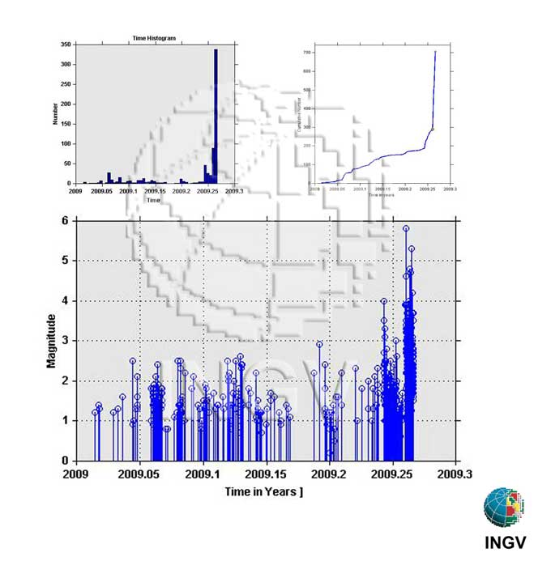

Slide 20
January 2010, Papadopoulos et al. :
"Our results indicate the importance of the value of
foreshock sequences for prediction of the main shock "
October 2011, Amato and Giaccio:
"Our analysis suggests that the seismic sequences alone can not be considered as direct precursors of strong incoming events"
In November 2014, Guidoboni and Valensise:
"The time evolution of the seismic sequences - and especially their foreshocks - has become topical in Italy following the earthquake that struck the central Abruzzo (Italy) April 6, 2009 (Mw 6.3, I0 IX MCS)”

Slide 21
Amato e Giaccio (2011):
The occurrence of earthquake swarms and sequences of low magnitude seems to be continuous in time and not related with the major events in the region of L'Aquila.
The 1915 earthquake of Avezzano-Fucino (7 M), with 33 000 deaths, felt as the degree VII-VIII MCS in L’Aquila was not preceded by foreshocks
Guidoboni * and Valensise (2015):
Knowledge of the history of the historical earthquake sequences and their complexity, including foreshocks, is crucial for a number of reasons.
Investigate the behavior of earthquake affected community in response to characteristics of each sequence, not only according to the severity of the earthquake but also in response to the specific model of foreshock.
…and finally demonstrate that both historical Aquila’s Earthquake and 1915 Avezzano Earthquake had a long and significant foreshocks sequence.

Slide 22
If we interpret the facts described as a mixture of science and politics, there is something ambiguous about the relationship between science and politics, in the case of L'Aquila.
the substance of the process is "disastrous reassurance”, scientific studies have a marginal role or have be used to disprove a procedural issue;
some scientific papers about data that have weighed on the first trial were published in a very short time before second trial decision. Others that were at odds were delayed.
the responsibilities of the media in the grand narrative of the "process of science”, skilled and unskilled, Italians and foreigners
the willingness of scientists to political power is the key to the whole affair;
lack of transparency in the processes of risk management and public participation was prevented
Inadequate preparations including not warning people for such possible eventuality.

Slide 23
In the Aquila case there is not only misunderstanding or confusion or lack of clarity in the roles, but an almost intentional fusion of roles, a kind of complicity, collusion or at least intimacy, between scientists and the CGR and DPC to the point that they failed to carry out their duty with independent judgment which is a condition essential for the Science.
Distribution of biased information and hinder the contradictory scientific debate casts a shadow on the ethics of some decisions of the editors and the peer review system.
We conclude that the lack of ethics on the part of scientists in L’Aquila case is severe and an important aspect .
This communication is based on two main works
Stoppa Francesco, Chiara Berti (2013). Reducing seismic risk by understanding its cultural roots: Inference from an Italian case history. Natural Science, 5, 78-91
Michael Yeo (2014). Fault Lines at the interface of science and policy: Interpretative responses to the trial of scientists in L'Aquila. Earth-Science Reviews, 139, 406-419

Slide 24
Thank you very much for the attention

